Slide 1

Cybersecurity Awareness: Recognizing Phishing Attacks
BY JIDECHI NWACHUKWU

Slide 2
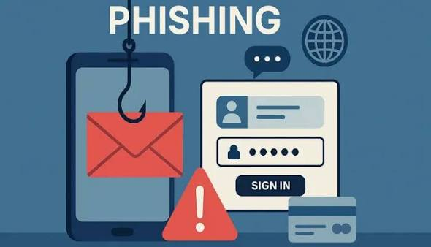
What is Phishing?
According to the National Cyber Security Centre (NCSC), “Phishing is when attackers send scam emails (or text messages) that contain links to malicious website. This means these malicious websites may contain viruses or malware which destroys or causes harm or sabotages the system software and its components.
Another definition of phishing can be stated according to IBM, which says, “Phishing is a type of cyberattack that uses fraudulent emails, text messages, phone calls or websites to trick people into sharing sensitive data, downloading malware, or otherwise exposing themselves to cybercrime.
These types of phishing attack are targeted towards making the user a victim of cyber crimes by exposing their confidential information such as passwords.
Phishing is still one of the most prevalent and hazardous forms of cybercrime around the world. Knowing how phishing attacks occur, identifying its signs, and adhering to cybersecurity protocols play essential roles in stopping such cybercrime from happening.

Slide 3
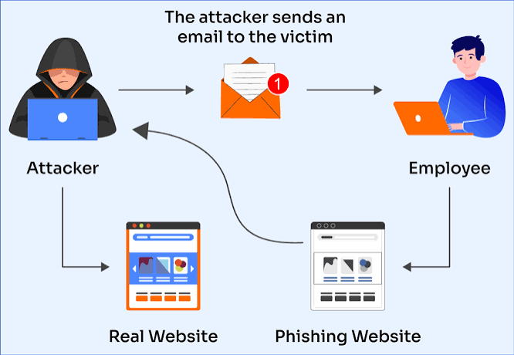
Why Phishing Works?
The reason why phishing works is that it takes advantage of people through sending them urgent emails stating that “your password expires today” or “your account will be terminated.” The moment one sends a message to a person and that person receives the message, they are immediately exposed to the attack

Slide 4

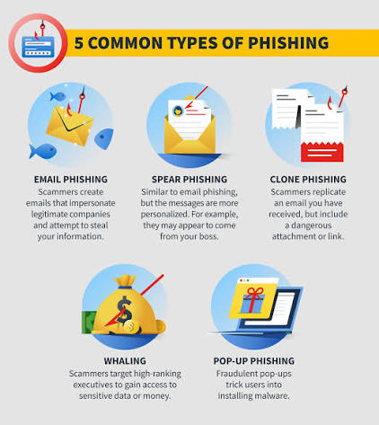
Types of Phishing
Here are some common types of phishing attacks: 1. Email phishing: This is the most popular phishing method whereby scammers use fake domains that impersonates companies, organization, industries, etc. and sends multiple messages to different users.
2. Spear phishing: Similar to any other phishing attack, communication is initiated from a “source that looks trustworthy” to deceive the victim. However, unlike other phishing attacks, the spear phishing approach targets a particular individual, or group of individuals instead of randomly attacking multiple users.
3. Clone phishing: In this form of phishing attack, the phishing e-mail copies the previous legitimate e-mails from the trusted sources. The attackers use deception on the link, where they can change the original link from the first e-mail to a new link directing the victim’s browser to an illegitimate website that copies the legitimate one. 4. Whaling: This is a form of phishing where scammers target high-ranking executives to gain confidential and exclusive information from them or steal money from them.
5. Pop-up Phishing: Although most people use pop-up blockers, pop-up phishing can be quite dangerous. The attackers hide the code for the malware in these small windows known as pop-ups. When the person attempts to access a particular website, they will receive notification that this website whishes to show its notifications. By clicking on “Allow,” they download the malware.

Slide 5
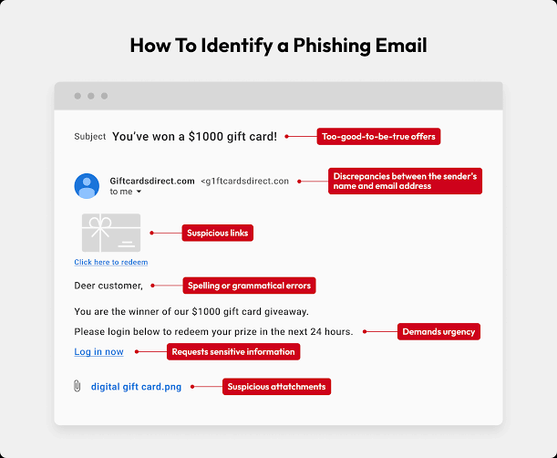
Recognizing Phishing Emails
There are some common patterns associated with this attack which makes it able to detect phishing emails:
Fake domains: These often contain character substitutions, such as covering up the letter “m” by using “r” and “n” next to each other to look like it.
Email addresses: Users should always check their email address when a message prompts them to download a file/document/attachment as well as clicking a common link. They could also use a legitimate company’s name in the local part of the email address with the sender’s name appearing in the inbox (e.g. p****@organization.com).

Slide 6
Social Engineering Tactics
According to the European Council, Council of the European Union, “Social engineering is a strategy used by individuals or groups to manipulate and device people into revealing sensitive information or performing actions that compromise their security. These are tactics used by attackers, such as persuasion, impersonation, etc. to extract confidential information from users. They can take various forms and techniques which include: 1. Impersonation: Pretending to be someone else. Attackers pretend to gain trust, either online or in person, to manipulate their victims into revealing sensitive information.
2. Angler phishing: This is when attackers mostly target social media users, often taking advantage of their popularity or trending topics to create deceptive messages while making them appear relevant and trustworthy.
3. Vishing: This usually occurs through phone calls, voice communication. These attackers impersonate trusted entities and persuade victims to reveal sensitive information.

Slide 7
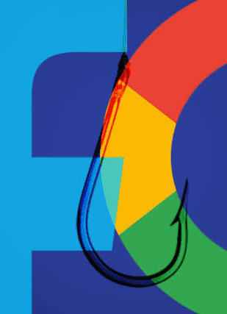
Real-World Examples
Here are some real-world examples of these phishing attacks:
Google and Facebook Phishing Attack: During 2013-2015, there was a phishing attack on Facebook and Google, causing financial losses worth $100 million. The attackers used the loophole that both companies use the same Taiwanese contractor company, known as Quanta. They issued a chain of fake invoices, making themselves appear as Quanta and getting money from the two companies.
USPS Phishing Attack: Smishing attacks that occurred in 2020 exploited the United States Postal Service (USPS). The cyber attackers sent SMS messages informing their targets to visit the link so that they could see crucial information regarding a pending delivery by the USPS. However, clicking on the link redirected the users to a number of websites where Google credentials were harvested.
Levitas Capital Phishing Attack: In 2020, the Australian hedge fund Levitas Capital was subjected to a whaling attack on its co-founder, The co-founder received an email which had a fake Zoom link. On clicking this link, a malware infected the corporate network of the hedge fund and generated fake invoices for about $8.7 million. The loss suffered by the company due to this attack amounted to only $800,000 but the damage to the reputation of the hedge fund led to its closure as they lost their client.

Slide 8
Best Practices and Tips
These are some practices that should be done, as well as tips, regularly, which include:
DO:
Verify Sender email addresses
Hover over links before clicking
Use MFA
Report suspicious emails
Verify requests through another channel
Keep software updated
Use strong unique passwords

Slide 9
Best Practices and Tips Cont’d
DON’T:
Open unexpected attachments
Share passwords
Trust urgent requests automatically
Click shortened links blindly
Send sensitive data through email

Slide 10
Quiz
Question 1:
What is Spear Phishing?
A. Random mass emails
B. Targeted phishing against specific individuals
C. Physical theft
D. Malware scanning
Question 2:
An email from your CEO requests an urgent wire transfer. What should you do?
A. Send it immediately
B. Ignore it
C. Verify through another communication channel
D. Forward to coworkers

Slide 11
Quiz Cont’d
Question 3
Before clicking a link, what should you do?
A. Click quickly
B. Forward it
C. Hover over it to inspect the URL
D. Download attachments

Slide 12
Quiz Cont’d
Scenario 1:
You receive a message from HR asking you to log into a new payroll portal using a link provided in the email.
What should you do first?
A. Click the link
B. Reply with your password
C. Verify with HR and visit the portal through the official company website
D. Ignore permanently
Scenario 2
You receive an SMS:
Your package delivery failed. Click here to reschedule.
What phishing technique is this?
A. Vishing
B. Smishing
C. Tailgating
D. Baiting

Slide 13
Quiz Cont’d
Scenario 3
Someone calls claiming to be IT support and asks for your password to fix a problem.
What should you do?
A. Share the password
B. Give only part of the password
C. Refuse and verify through official channels
D. Change the password after sharing

Slide 14
Quiz Answers
Question 1:
B
Question 2:
C
Question 3:
C
Scenario 1:
C
Scenario 2:
B
Scenario 3:
C

Slide 15
References
https://www.ibm.com/think/topics/phishing
https://www.bluevoyant.com/knowledge-center/8-devastating-phishing-attack-examples-and-prevention-tips
https://www.ncsc.gov.uk/guidance/phishing
https://www.consilium.europa.eu/en/policies/cybersecurity-social-engineering/

